Slide 1

Implementing Results of Quantitative Models
Richard C. Larson
1.203J, 15.073J, IDS.700
December 4, 2017

Slide 2

Cases
Don’t take my men away! (NYPD, PCAM)
I’ve seen consultants come and go.. (DSNY)
Vanishing advocate (EMS, and more)
911 queueing P= T=
ATA living in the system.. lawnchairs
Framingham school busses
The 90-10 rule (USPS)

Slide 3
People and Institutional Issues
Question the phrase: “Optimal Solution”
The user’s attributes and reward structure
The analyst
Institutional setting and its constraints
Other stakeholders, & multiple objective functions
Building a broadly based constituency
Training the user and the learning curve
Don’t agree to prove a result pre-selected as best!

Slide 4
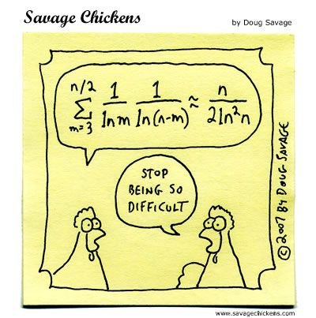
Quantitative Policy Modeling

Slide 5
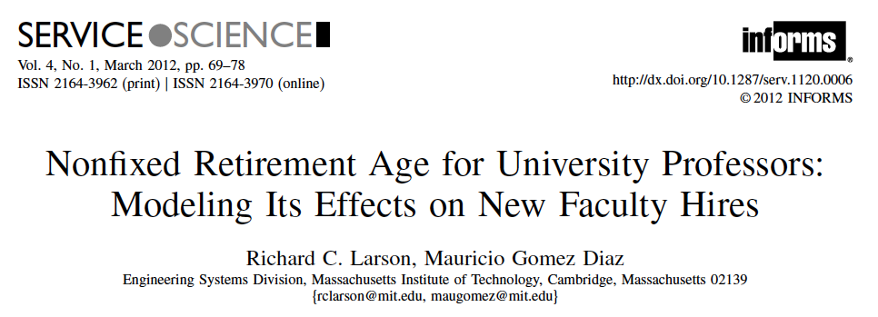
NIH Question

Slide 6
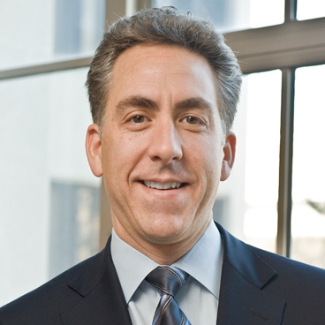
Retirement Model was used by
Ian Waitz, former Dean,
MIT School of Engineering

Slide 7


Birth Rates for University Professors

Slide 8
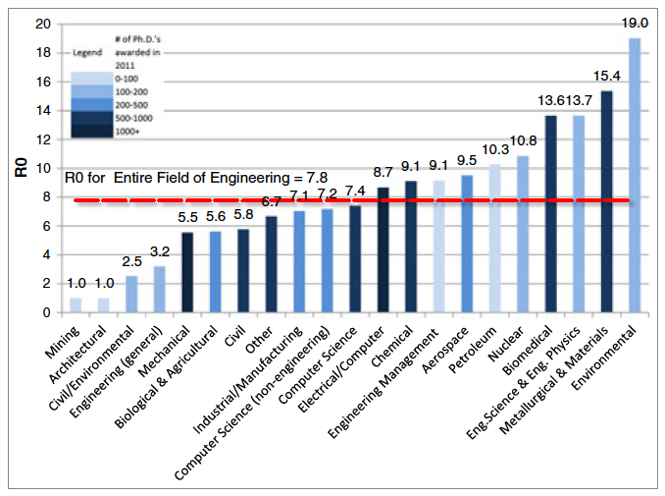
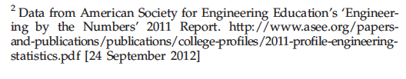

Slide 9
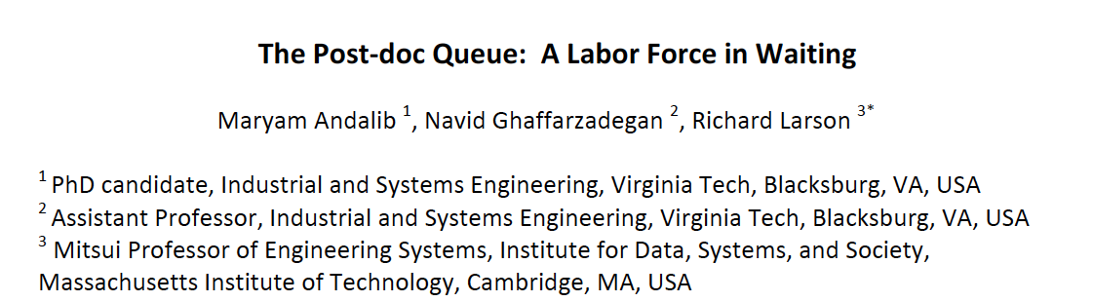
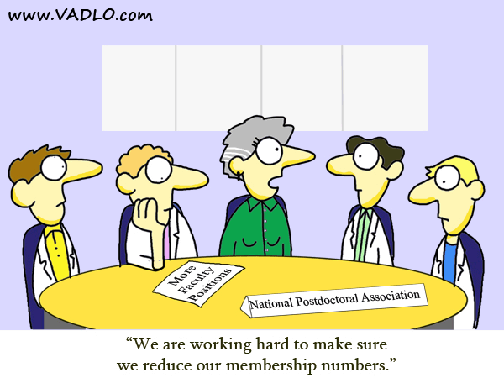

Slide 10

Early Euphoria
Severe Hangover

Slide 11


CDC “Algorithm”

Slide 12


Slide 13


